Slide 1
Tutorial: Writing ArcGIS Metadata for 100% InPort Score
Environnemental Data Management Conference
Sept. 14, 2022
11:45am – 1:15pm ET
Office of Science and Technology
Presenters: John Kennedy and Tim Haverland
Notes:
Greetings and thank you for attending our session on ArcGIS Metadata and
working towards a 100% rubric score for a new InPort record
Presenting today will be myself, John Kennedy, and the NOAA Fisheries GIS
lead Tim Haverland
1) As you read in the session description, InPort is a metadata authoring and cataloguing web-based application that is used by multiple NOAA line offices
2) For this tutorial we will use ArcGIS Pro to create and manage metadata records
3) We'll go through an example of writing a complete ArcGIS metadata file (using a handy dandy guide in Google sheets) that can then be loaded into the InPort metadata application, with the goal of getting an InPort 100% Rubric score
3) You can follow along as we go through the example, or you can join us as we go through the process
4) Please feel free to interrupt with a question during the presentation
5) Before we get started, are there any questions?
<NEXT SLIDE>

Slide 2
What’s Needed
ArcGIS Pro 2.7.x or higher
The Handy Dandy “Guidance for ArcGIS Pro Metadata in InPort” spreadsheet
The “EDMW InPort ArcGIS Pro Demonstration 2022” folder containing this presentation, the ArcGIS Pro map package (EDMW InPort ArcGIS Pro Demonstration 2022.mpkx) used in the tutorial, and the sample metadata XML files
InPort Author or higher credentials are needed
Notes:
So, what's needed?
1) ArcGIS Pro 2.7.x or higher. If you only have ArcGIS Desktop 10.x installed we can go over that process if we have time at the end of this session or we can meet at another time to discuss the specifics
2) The Handy Dandy Guidance for ArcGIS Pro Metadata in InPort spreadsheet. In Google Drive search for "Guidance for ArcGIS Pro Metadata in InPort“ and select the second worksheet
3) The EDMW InPort ArcGIS Pro Demonstration 2022 folder containing this presentation, the ArcGIS Pro map package used in the tutorial, and the sample metadata XML files. In Google Drive search for "EDMW InPort ArcGIS Pro Demonstration 2022" and download the Map Package
4) InPort Author or higher credentials are needed
<NEXT SLIDE>

Slide 3
Fun with ArcGIS Pro! Part #1
Open the map package. After clicking the map package ArcGIS Pro creates a folder under My Documents \ ArcGIS \ Packages. Save the Project into the same folder
Verify the metadata style being used: ArcGIS Pro > Settings > Options > Metadata > Metadata Style > North American Profile of ISO 19115 2003
This map package contains a set of feature classes, a raster mosaic, and a stand-a-lone table. Each of these has a metadata record that can be used as an example
Use the View tab to open the Catalog View. In the Contents pane, right-click Folder and select "Add Folder Connection". Now navigate to "commondata", then select "userdata", and then click OK. Right-click the "userdata" and rename the folder to "Metadata"
Notes:
1) Open the map package. After clicking the map package ArcGIS Pro creates a folder under My Documents \ ArcGIS \ Packages. Save the Project into the same
folder
2) Verify the metadata style being used: ArcGIS Pro > Settings > Options > Metadata > Metadata Style > North American Profile of ISO 19115 2003
3) This map package contains a set of feature classes, a raster mosaic, and a stand-a-lone table. Each of these has a metadata record that can be used as an example
4) Use the View tab to open the Catalog View. In the Contents pane, right-click Folder and select "Add Folder Connection". Now navigate to "commondata", then select "userdata", and then click OK. Right-click the "userdata" and rename the folder to "Metadata“
<NEXT SLIDE>

Slide 4
Fun with ArcGIS Pro! Part #2
Now do the same as above, but navigate to the "p12" folder and connect
In the Contents pane right-click Databases and select "Add Database“. Navigate to the p12 folder and then select the File Geodatabase (dismap_july_17_2022_dev.gdb)
Notes:
1) Now do the same as above, but navigate to the "p12" folder and connect
2) In the Contents pane right-click Databases and select "Add Database". Navigate to the p12 folder and then select the File Geodatabase
3) Use Windows Explorer (File Manager) to locate the "Metadata“ folder and then extract the "DisMAP Project Template" zip file. Return to ArcGIS Pro and refresh the "Metadata" folder
4) In the Contents pane right-click Toolboxes and select "Add Toolbox". Navigate to the "Metadata" folder and then select the "DisMAP Project Template" toolbox
<NEXT SLIDE>

Slide 5
Fun with ArcGIS Metadata! Part #1
Return to and select the "Metadata" folder, on the Catalog ribbon locate the Metadata icon group
Click the down-arrow on the Save As item, then select "Save As XML" and "All Content", then navigate to the "Metadata" folder and then save the XML file as "empty“. Return the "Metadata" folder and refresh
In the Contents Pane expand the Databases folder, then click the File Database (dismap_july_17_2022_dev.gdb), and then click the Study Regions Feature Class. This previews the existing metadata for this item, which is mostly empty as no metadata has been added
On the Metadata icon group, click Synchronize, this adds the basic ArcGIS metadata
Notes:
1) Return to and select the "Metadata" folder, on the Catalog ribbon locate the Metadata icon group
2) Click the down-arrow on the Save As item, then select "Save As XML" and "All Content", then navigate to the "Metadata" folder and then save the XML file as "empty". Return the “Metadata" folder and refresh
3) In the Contents Pane expand the Databases folder, then click the File Database, and then click the Study Regions Feature Class. This previews the existing metadata for this item, which is mostly empty as no metadata has been added. On the Metadata icon group, click Synchronize, this adds the basic ArcGIS metadata
<NEXT SLIDE>

Slide 6
Fun with ArcGIS Metadata! Part #2
Now select the “DisMAP Regions” Feature Class and review the existing metadata. Return to the Metadata icon group and select "Save As“
And then "Save As XML“ and select "Without Sensitive Info", then navigate to the "Metadata" folder and then save the XML file as "DisMAP_Regions.xml"
Now return to the Catalog tab, navigate to the "Metadata" folder, select the "DisMAP_Regions.xml" file, and then click Edit. This opens the XML in the metadata editor
Return to the File Geodatabase by clicking the Catalog tab, then Databases, then the File Geodatabase, and then select the "Study Regions“ Feature Class
On the Metadata icon group select Edit
Optionally you can do the same for the NEUS_F raster mosaic and the NEUS_F_Indicators table to compare the differences between metadata for these items
Notes:
Now select the DisMAP_Regions Feature Class and review the existing metadata. Return to the Metadata icon group and select "Save As". "Save As XML“ and select "Without Sensitive Info", then navigate to the "Metadata" folder and then save the XML file as "DisMAP_Regions.xml“
Now return to the Catalog tab, navigate to the "Metadata" folder, select the "DisMAP_Regions.xml" file, and then click Edit. This opens the XML in the metadata editor
Return to the File Geodatabase by clicking the Catalog tab, then Databases, then the File Geodatabase, and then select the "Study Regions" Feature Class. On the Metadata icon group select Edit
Optionally you can do the same for the NEUS_F raster mosaic and the NEUS_F_Indicators table to compare the differences between metadata for these items
<NEXT SLIDE>

Slide 7
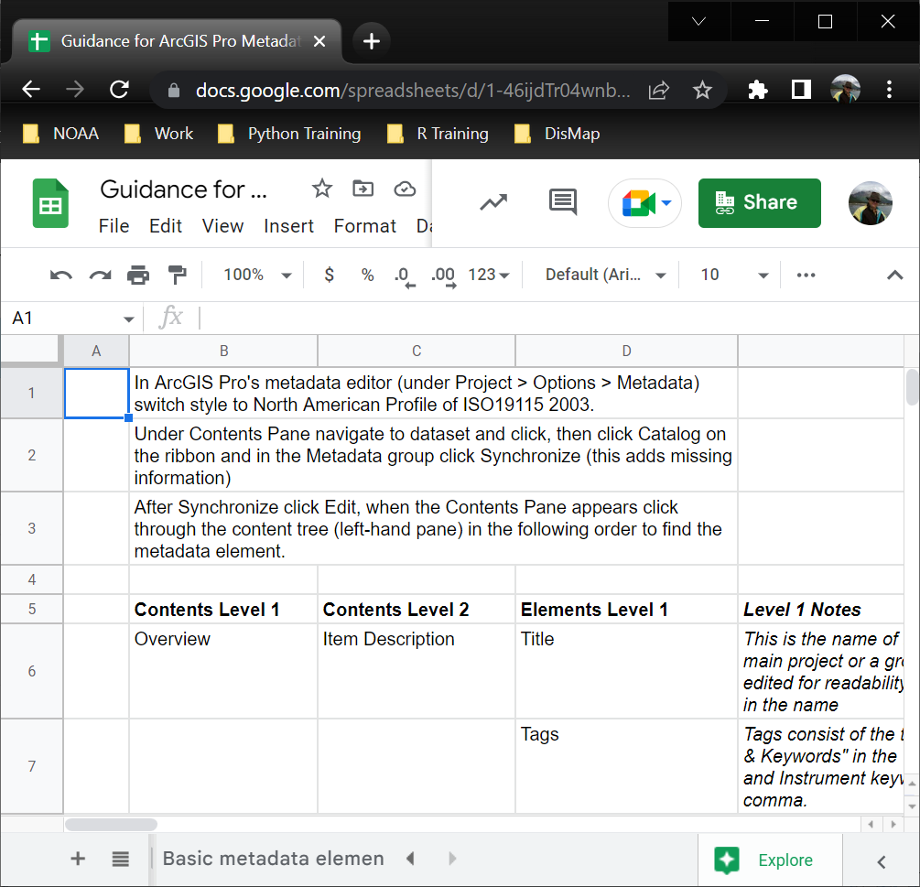
Fun with InPort Metadata Part #1
Bring up the Handy Dandy “Guidance for ArcGIS Pro Metadata in InPort” spreadsheet and make a copy so you can highlight your progress
Select the “Updated Metadata Elements Guide 20220528” worksheet
The guide is designed to follow the elements in the ArcGIS metadata editor and cross-references the InPort elements
Some common issues we've encountered
Contacts (email address) listed in the ArcGIS metadata record not having an account in InPort
Organization name inconsistencies
Dates not being assigned
Notes:
Bring up the Handy Dandy Guidance for ArcGIS Pro Metadata in InPort spreadsheet and make a copy so you can highlight your progress. The spreadsheet contains two worksheets
The basic metadata element worksheet contains the elements necessary to reach a 100% rubric score in InPort
The updated metadata elements guide worksheet contains more details about which elements need to be completed to get the 100% rubric score in InPort feature classes, stand-alone tables, and raster datasets. In addition, this worksheet contains information to complete the ArcGIS metadata requirements using the North American Profile for ISO 19115 2003
The guide is designed to follow the elements in the ArcGIS metadata editor. It also offers notes along the way and
Some common issues we've encountered:
Users listed in the ArcGIS metadata record not having an account in InPort
Organization name inconsistencies
Dates not being assigned
<NEXT SLIDE>

Slide 8
Fun with ArcGIS Metadata! Part #3
Return to ArcGIS Pro and the Metadata editor
We’ll use the DisMAP Region metadata as a source to copy and paste content to the Study Regions metadata
As we go from item to item, we’ll mark the guide with a cell fill to keep tract of our progress
Extents issue: -179.999989. 179.999989
Save the edits and exit the metadata editor
Return to the “Study_Regions” feature class and then in the Metadata icon group and select "Save As“
Then select "Save As XML“, select "Without Sensitive Info", then navigate to the "Metadata" folder and then save the XML file as “Study_Regions.xml"
Notes:
Now return to ArcGIS Pro and the Metadata editor
We’ll use the DisMAP Region metadata as a source to copy and paste content to the Study Regions metadata
As we go from item to item, we’ll mark the guide with a cell fill to keep tract of our progress
Save the edits and exit the metadata editor
ArcGIS Pro doesn’t like it when the western extent is greater than the eastern extent, so we’ll enter the values from the bounding box under Item Description Bounding Box: -179.999989. 179.999989
Return to the “Study_Regions” feature class and then in the Metadata icon group and select "Save As“
Then select "Save As XML“, select "Without Sensitive Info", then navigate to the "Metadata" folder and then save the XML file as “Study_Regions.xml"

Slide 9
Fun with InPort Metadata Part #2
Go to InPort (https://www.fisheries.noaa.gov/inport/) and login
Then navigate to an InPort project and login to load the new metadata record
To create a new InPort Data Set metadata record
Use Item > Add Child Item > Catalog Item Type: Data Set > Title: Study Regions 20220516 > Create
Go to Dataset "Study Regions 20220516“
Use Item > Update Item From File > Custom XML File > Replace Existing Catalog Item?: Yes > Upload Custom XML File: Study_Regions.xml > XSLT Transform to Apply: ArcGIS XML to InPort All-In-One V02 (Tim Haverland) > Update > Finish
Go to Dataset "Study Regions 20220516“
Review the geographic extent
Edit the XML in a text editor for the geographic extent fix
Notes:
Now that we have an ArcGIS metadata file to use, we’ll start the InPort app and load the XML file
Go to InPort, login, and then navigate to a project. We’re using the DisMAP project for this example
On the project page, select Item and then Add Child Item. Under Catalog Item Type select Data Set, and then enter the Title as Study Regions 20220516 and then click Create
At this time there is a bug in InPort that does not allow creating a new InPort record from an ArcGIS metadata file, which was possible in the previous release. This will be fixed in the next release available in a month or so
Now return to the "Study Regions 20220516“ InPort record, select Item, then Update Item From File, select Custom XML File, under Replace Existing Catalog Item? Select Yes, then under Upload Custom XML File navigate to the Study_Regions.xml file, under XSLT Transform to Apply verify ArcGIS XML to InPort All-In-One V02 (Tim Haverland), then select Update, and after review, select Finish
Return to the "Study Regions 20220516“ InPort record and review the geographic extent. Notice that the first extent wraps around the world
We’ll fix this using a text editor on the Study_Regions.xml
<NEXT SLIDE>

Slide 10
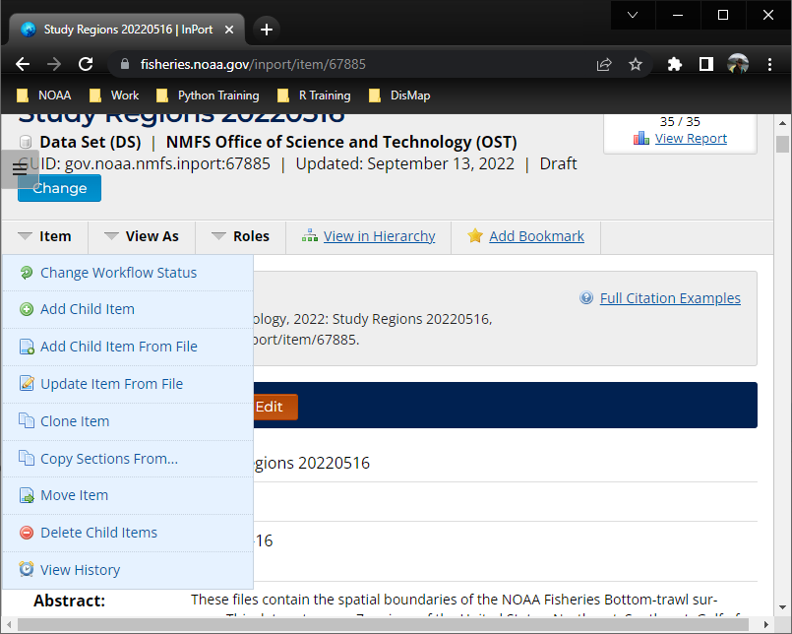
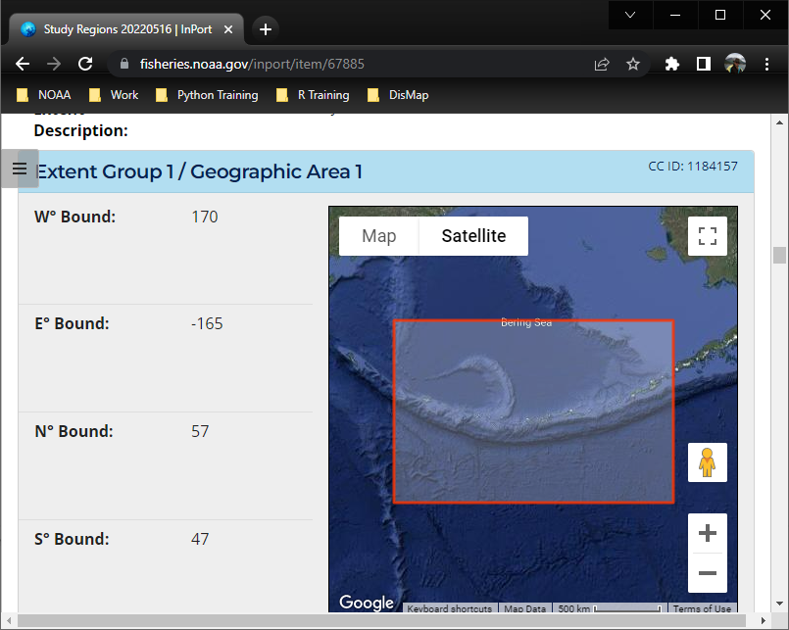
Fun with InPort Metadata Part #3
Update the InPort record with the edited ArcGIS metadata file
Use Item > Update Item From File > Custom XML File > Replace Existing Catalog Item?: Yes > Upload Custom XML File: Study_Regions.xml > XSLT Transform to Apply: ArcGIS XML to InPort All-In-One V02 (Tim Haverland) > Update > Finish
Go to Dataset "Study Regions 20220516“
Review geographic extent
Return ArcGIS Pro to load the edited XML to the Study_Regions feature class
Notes:
In the text editor, change the -179.999989 value to 170 and the 179.999989 value to -165. Save the file.
The edited XML file now can be used to overwrite the InPort record
Go to the InPort record and use:
Item
Update Item From File
Select Custom XML File
For Replace Existing Catalog Item? select Yes
And then under Upload Custom XML File navigate to the edited Study_Regions.xml file
And then under XSLT Transform to Apply check if ArcGIS XML to InPort All-In-One V02 (Tim Haverland) is selected
Then click Update and then Finish
Return to the InPort record for the dataset and review the geographic extent
<NEXT SLIDE>

Slide 11
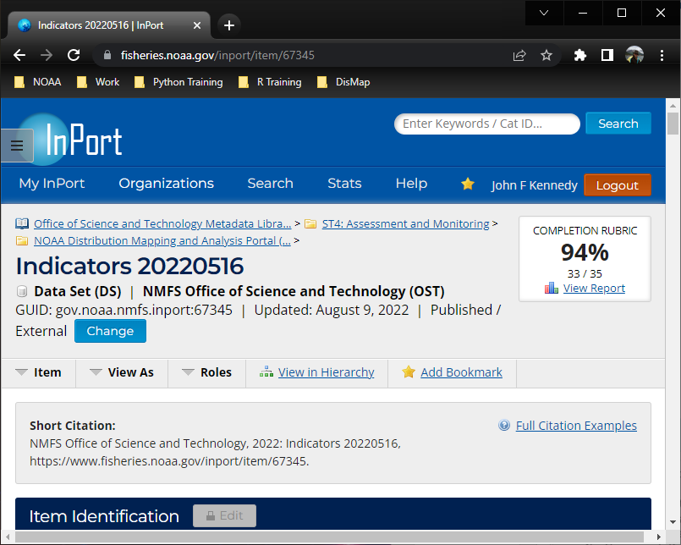
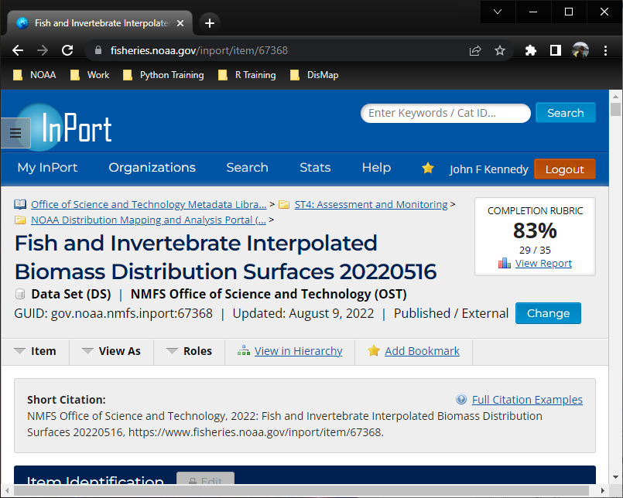
Additional Comments on the Rubric
Some data sets may have less than 100% score and that’s OK
Tables without coordinates don’t have a geographic or temporal extent
Raster data may not have an attribute table
There are InPort elements that can, if populated, give extra credit
Notes:
Some data sets may have less than 100% rubric score and that’s OK. It is something to discuss with your team and the InPort librarian you are working with
Tables without coordinates don’t have a geographic extent to record. They also may not have a temporal extent as well
Raster data may not have an attribute table in ArcGIS Pro and so a child entity will not be created. You can add attribute information into the ArcGIS metadata, however
There are InPort elements that can, if populated, give extra credit. These are items that can improve the usefulness of the InPort record for your end users, but are not a part of the rubric score itself. For example, one or more theme keyword thesauruses can be added to assist with word or phase definitions or a browse graphic that shows a map or gives an example of the data
<NEXT SLIDE>

Slide 12
Advanced: ArcGIS Pro, Python & ArcPy
from arcpy import metadata as md
# Create a new Metadata object
new_md = md.Metadata()
# Basic XML File
new_md.title = 'My Title'
new_md.tags = 'Tag1, Tag2'
new_md.summary = 'My Summary'
new_md.description = 'My Description'
new_md.credits = 'My Credits'
new_md.accessConstraints = 'My Access Constraints'
# Save Basic XML File
new_md.saveAsXML("basic.xml")
del new_md
Notes:
Starting with ArcGIS Pro 2.7 the arpy.metdata module has the ability to create basic metadata as shown here
This code can be loaded into the Python window to create a basic metadata file. It can also be a part of a Python script to create the basic metadata XML file
There are three Python scripts in the project folder. The first script, create_empty_xml, can create an empty XML file, the create_basic_xml script contains the code on this slide, and the third script, pretty_format_xmls, can reformat into easily readable form the XML files in a directory
These script can be expanded upon to help with importing and export ArcGIS metadata files for your project
<NEXT SLIDE>

Slide 13
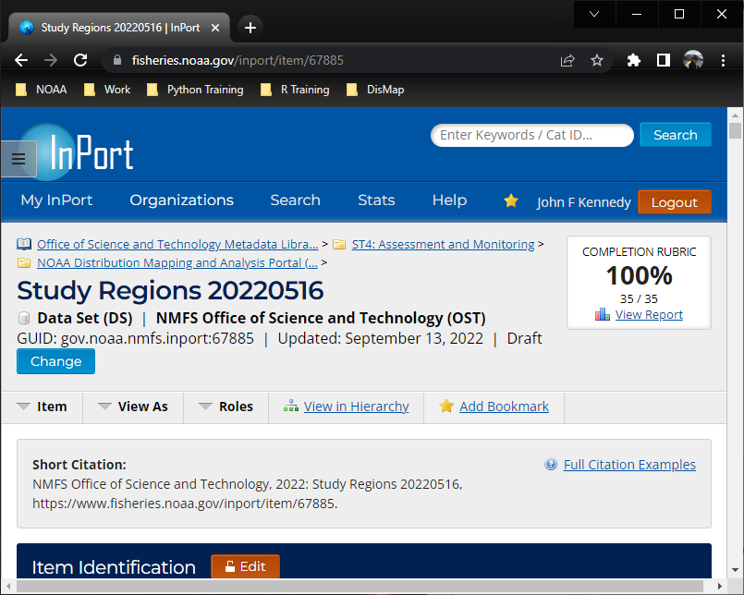
In closing
This presentation has shown how to use the guide to create and manage ArcGIS metadata for 100% InPort score
It’s possible to use the arcpy.metadata module to automate the importing/exporting of metadata using Python
Questions?
Notes:
This presentation has shown how to use the handy dandy guide to create and management ArcGIS metadata for a 100% rubric score. Plus a lot of other details
It’s possible to use the arcpy.metadata module to automate the importing/exporting of metadata using Python
We now have some time to discuss any question about the presentation, perhaps provide some one-on-one help, or dig into a detailed use case
<NEXT SLIDE>

Slide 14
InPort Questions, Comments and Feedback
The InPort Team welcomes questions, comments and feedback from the InPort community. Please email them at EDMjira.inport@noaa.gov
If there is a need for immediate assistance, please contact Lee Weinberger (lee.weinberger@noaa.gov) at (305) 361-4287 between the hours of 9:00am - 4:00pm Eastern
Notes:
1) If you have any general questions, comments, or feedback, please feel free to contact the InPort team

